Slide 1
EBN 111/122 ELECTRICITY AND ELECTRONICS
Chapter 1
Basic Concepts
Copyright © The McGraw-Hill Companies, Inc. Permission required for reproduction or display.

Slide 2
Basic Concepts - Chapter 1
1.1 Systems of Units.
1.2 Electric Charge.
1.3 Current.
1.4 Voltage.
1.5 Power and Energy.
1.6 Circuit Elements.
L#1
L#2

Slide 3
Chapter 1: Lecture #1 1.1 System of Units (1)
Six basic units: SI Units
Quantity | Basic unit | Symbol
Length | meter | m
Mass | kilogram | kg
Time | second | s
Electric current | ampere | A
Thermodynamic temperature | kelvin | K
Luminous intensity | candela | cd

Slide 4
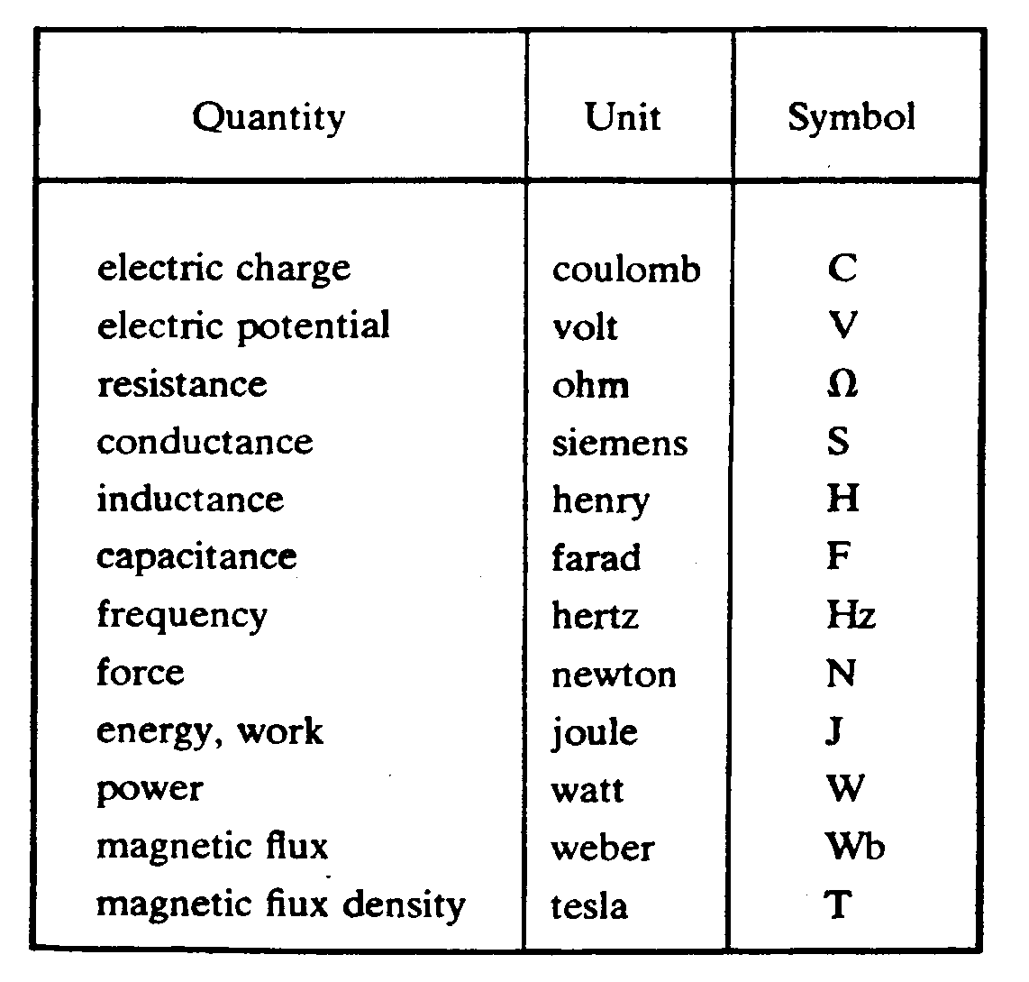
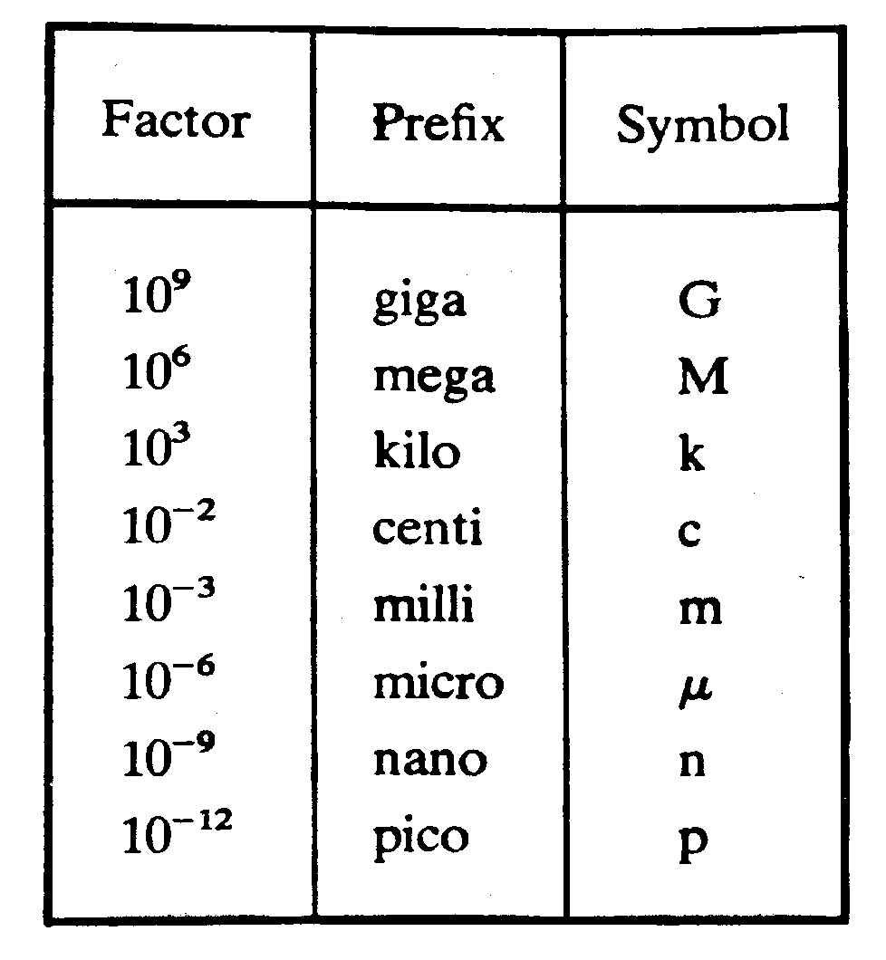
1.1 System of Units (2)
The derived units commonly used in electric circuit theory
Decimal multiples and submultiples of SI units

Slide 5
1.2 Electric Charge
Charge is an electrical property of the atomic particles of which matter consists, measured in coulombs (C).
The charge e on one electron is negative and equal in magnitude to 1.602 × 10⁻¹⁹ C which is called an electronic charge.
1 C = 1/e = 6.24 x 10¹⁸ electrons
The charges that occur in nature are integral multiples of the electronic charge e.
Law of conservation of Charge: Charge can neither be created nor destroyed, it can only be transferred.

Slide 6
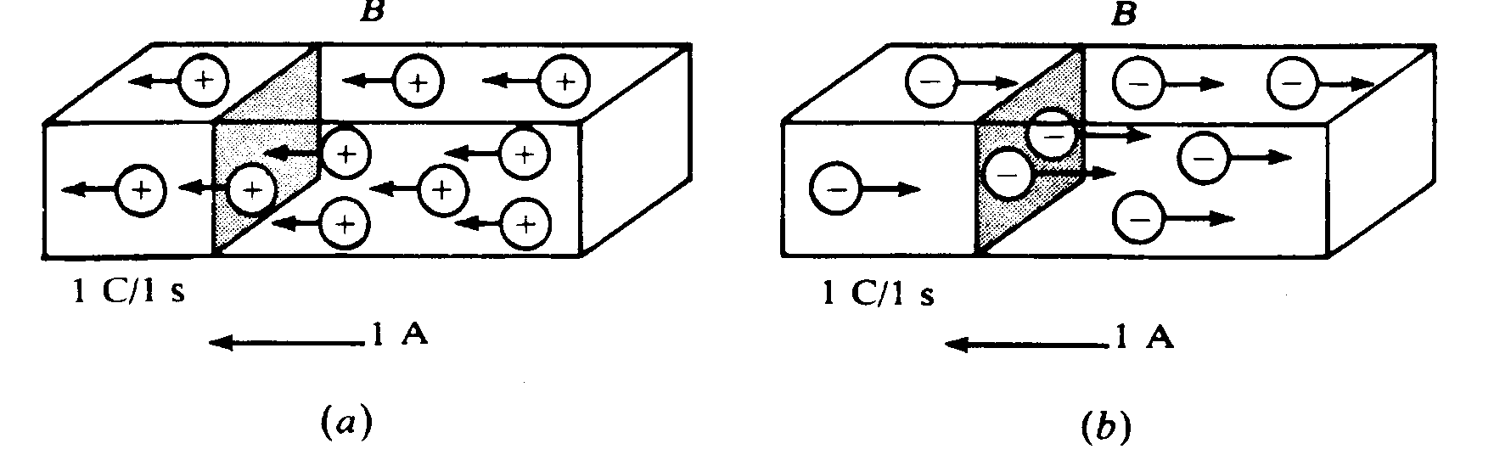
1.3 Current (1)
The direction of current flow
Motion of charge creates electric current.
Benjamin Franklin (1706 – 1790): Convention: Current flows in the direction of positive charge.
Years later it was found that it is actually Free Electrons moving in the opposite direction.
Positive ions
Negative ions

Slide 7
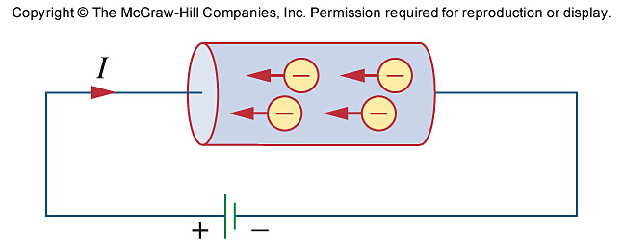
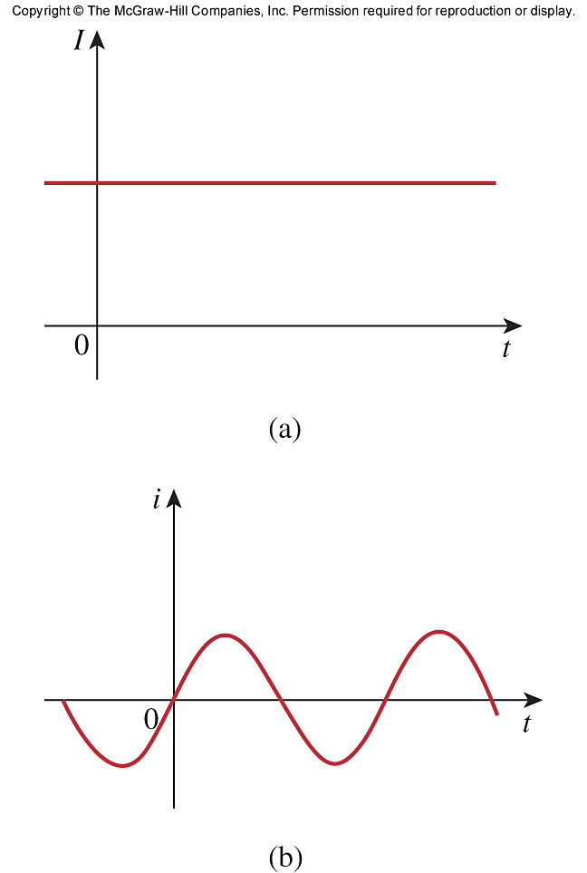
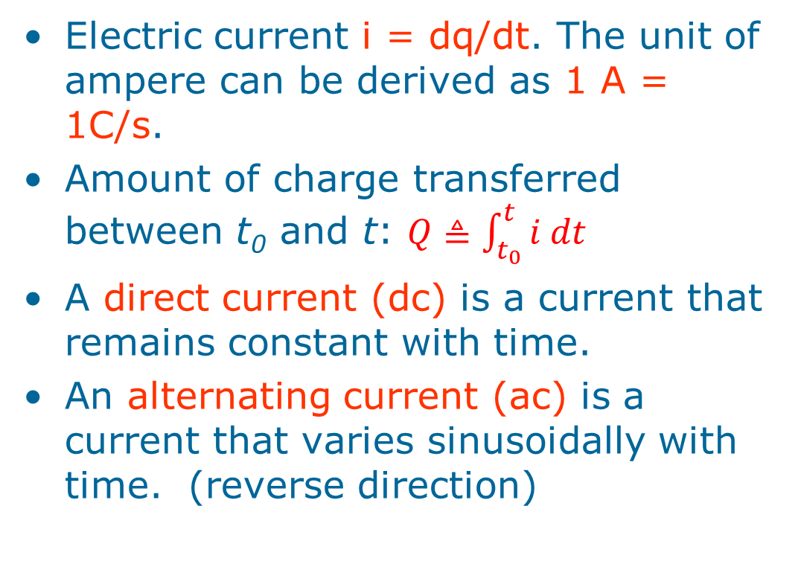
1.3 Current (2)

Slide 8
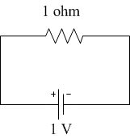
1.3 Current (3)
I₁= ?
I₂ = ?
I₁= +1A
I₂= -1A
I₁ = -I₂= 1A

Slide 9
PP1.1
Calculate the amount of charge represented by four million protons.
Q = 4x10⁶ x –e
= 4x10⁶ x –(–1.602x10⁻¹⁹C)
= +6.408x10⁻¹³C
= 0.6408x10⁻¹²C
= 0.6408 pC
= 640.8 fC

Slide 10
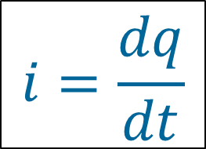
PP1-2 The total charge entering a terminal is given by q =(10 – 10e^{-2t}) mC. Find the current at t = 0.5s.
$$i=\frac{dq}{dt}$$

Slide 11
Differentiating means finding the slope or gradient
q =(10 – 10e^{-2t}) mC
Gradient @ 0.5s ≈ 7.4 mC/s ≈ 7.4 mA

Slide 12
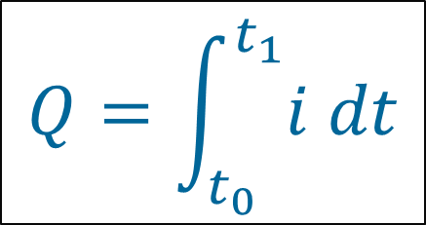
Example 1-3 Determine the total charge entering a terminal between t = 1 s and t =2 s if the current passing the terminal is: i = (3t² – t) A
$$Q=\int_{t_{0}}^{t_{1}}{i dt}$$

Slide 13
Integrating means finding the area underneath
i = (3t² – t) A
Area to be calculated:
7.8 A
1.7 A
Area = (2-1)s x (1.7 + 0.5x7.8)A
= 5.6 A⋅s
∴Q ≈ 5.6 C

Slide 14
1.4 Voltage
Voltage (or potential difference) is the energy (work) required to move a unit charge through an element, measured in volts (V).
Work is done by the electromotive force (emf) aka voltage or potential difference.
Mathematically, (volt)
w is energy in joules (J) and q is charge in coulomb (C).
voltage is change in energy per charge

Slide 15
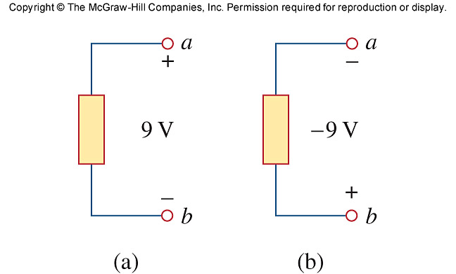
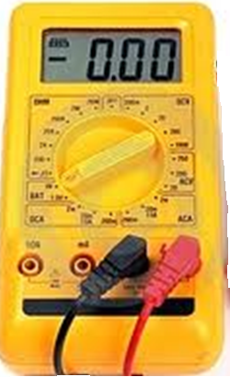
1.4 Voltage
Electric voltage, v_{ab}, is always across the circuit element or between two points in a circuit.
v_{ab} > 0 means the potential of a is higher than potential of b.
v_{ab} < 0 means the potential of a is lower than potential of b.
v_{ab} = - v_{ba}
+9.00
-9.00
v_{ab} = +9V
v_{ba} = -9V

Slide 16
Chapter 1: Lecture #2 1.5 Power and Energy
Power is the rate at which energy is consumed or delivered: Joules per second = Watt; [J/s =W].
Mathematical expression:
Instantaneous power = the rate at which energy is consumed at a specific point in time:
DC systems: p(t) = P = VI = constant
AC systems: p(t) = v(t)i(t) = time function

Slide 17
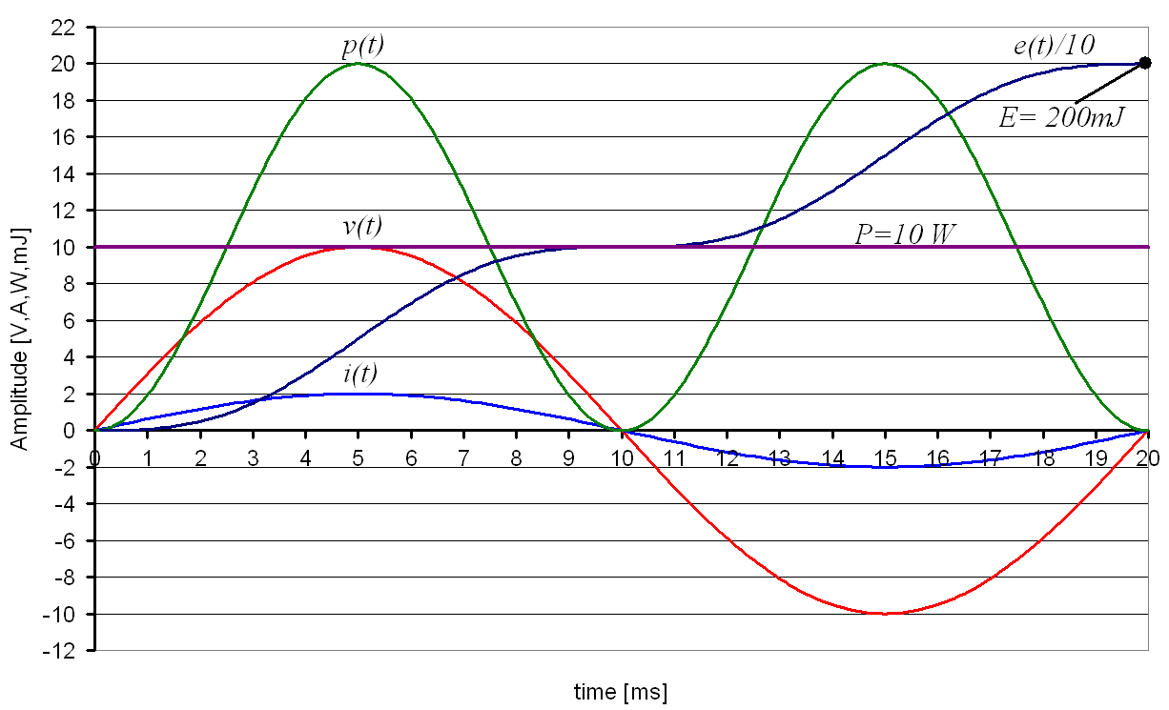
AC Power in a Resistor

Slide 18
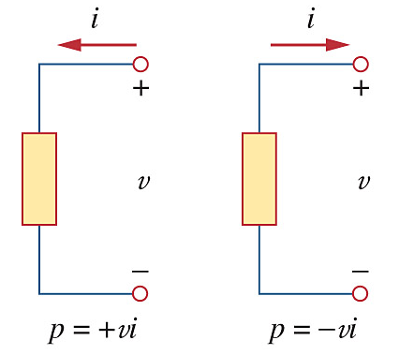
1.5 Power and Energy
Passive Sign Convention
If the reference current direction enters the positive terminal: p = +vi
If the reference current direction enters the negative terminal: p = -vi
p > 0: element is absorbing or consuming energy
p < 0: element is delivering or supplying energy

Slide 19
Calculate the power being absorbed or delivered (effect of changing polarity and direction):
2 A
2 A
+
p = +vi
= + (4)(2)
= 8 W
p>0:
Absorbs 8 W
p = -vi
= - (4)(2)
= -8 W
p<0:
Delivers 8 W
-
4 V
4 V
-
+
2 A
2 A
p = -vi
= - (4)(2)
= -8 W
p<0:
Delivers 8 W
p = +vi
= + (4)(2)
= 8 W
p>0:
Absorbs 8 W
+
-
4 V
4 V
-
+

Slide 20
Calculate the power being absorbed or delivered (effect of changing signs)
2 A
2 A
+
p = +vi
= + (4)(2)
= 8 W
p>0:
Absorbs 8 W
p = -vi
= - (-4)(2)
= +8 W
p>0:
Absorbs 8 W
-
4 V
-4 V
-
+
-2 A
-2 A
p = -vi
= -(4)(-2)
= +8 W
p>0:
Absorbs 8 W
p = +vi
= + (-4)(-2)
= 8 W
p>0:
Absorbs 8 W
+
-
4 V
-4 V
-
+

Slide 21
1.5 Power and Energy
The law of conservation of energy implies that in an electrical circuit p_{delivered} = p_{absorbed}, or:
Energy is the capacity to do work, measured in joules (J) or alternatively in Watt-hour (Wh).
1 Wh = 3600 J = 3.6 kJ
1 kWh = 3.6 MJ

Slide 22
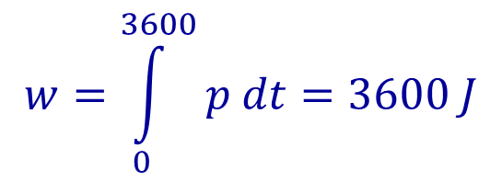
1.5 Power and Energy
Energy absorbed or delivered by an element between times t₀ and t₁ is:
$$w=\int_{0}^{3600}{p dt}=3600 J$$
P [W]
1
0
= 60 x 60s
= 3600s
1 hour
time [h]
An element consumes energy at a rate of 1 W for 1 hour – how much energy is that in Joule?

Slide 23
PP1-4 To move charge q = 2C from point a to b requires -30 J. Find the voltage drop v_{ab}.

Slide 24
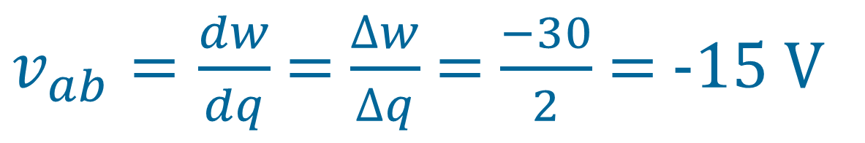
PP1-4 To move charge q = 2C from point a to b requires -30 J. Find the voltage drop v_{ab}.
$v_{ab}=\frac{dw}{dq}$ = $\frac{∆w}{∆q}$ = $\frac{−30}{2}$ = -15 V

Slide 25
PP1-5 Find the power delivered to an element at t = 5 ms if the voltage is v = 2i V the current entering its positive terminal is: i = 5 cos 60πt A.

Slide 26
PP1-5 Find the power delivered to an element at t = 5 ms if the voltage is v = 2i V the current entering its positive terminal is: i = 5 cos 60πt A.
p = +vi
= (2i)(i )
= 2 * (5 cos 60πt)²
= 50 cos²(60*π*5*10⁻³)
= 17.27 W
p>0:
Absorbs power
i = 5 cos 60πt A
+
v = 2i V
radians
-
NB: Calculator must be set to radians!
2π [rad] = 360°

Slide 27
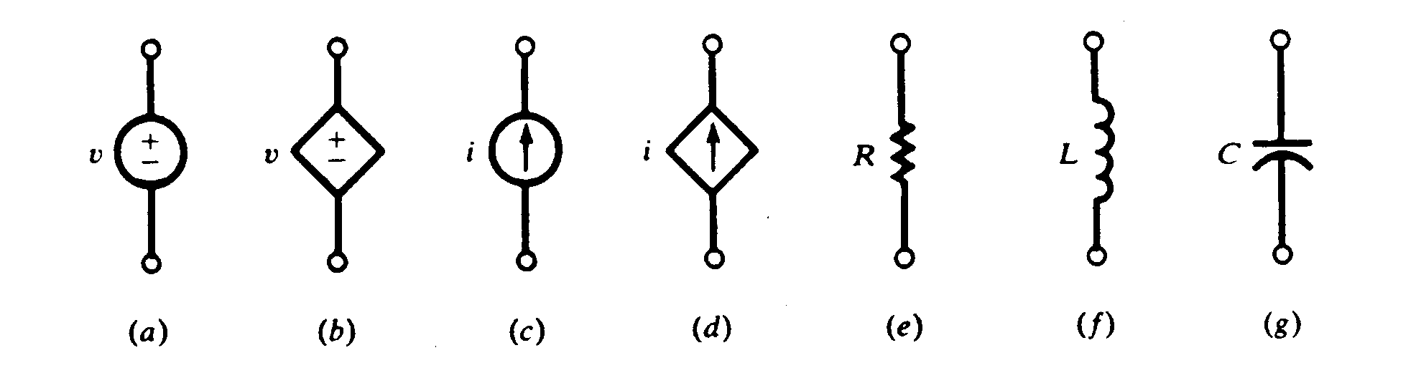
1.6 Circuit Elements (1)
Passive Elements
Resistors, Inductors, Capacitors
Active Elements (Energy Sources)
Generators, batteries, op-amps
A dependent source is an active element in which the source quantity is controlled by another voltage or current.
They have four different types: VCVS, CCVS, VCCS, CCCS. Keep in minds the signs of dependent sources.
Independent
sources
Dependant
sources

Slide 28
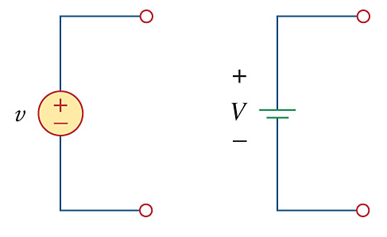
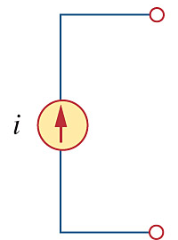
Ideal Independent Sources:
An active element that provides a specified voltage or current that is completely independent of other circuit elements. ROUND in shape.
I.e. If v = 10 V it stays 10 V no matter what!
If i = 5 A it stays 5 A no matter what

Slide 29
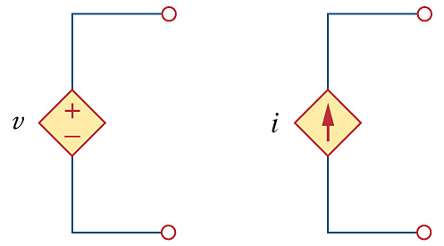
Ideal Dependent Sources:
An active element in which the source quantity is controlled by another voltage or current. DIAMOND in shape.
Useful in modeling elements such as transistors, operational amplifiers and integrated circuits.

Slide 30
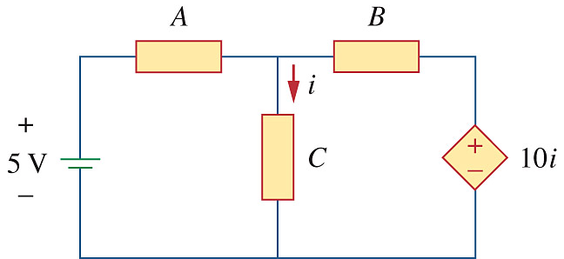
Types of Dependent Sources:
Four possible types of dependent (or controlled) sources:
VCVS = Voltage Controlled Voltage Source
CCVS = Current Controlled Voltage Source
VCCS = Voltage Controlled Current Source
CCCS = Current Controlled Current Source

Slide 31
PP1-6 A stove element draws 15 A when connected to a 240 V supply. How long does it take to consume 60 kJ?

Slide 32
PP1-6 A stove element draws 15 A when connected to a 240 V supply. How long does it take to consume 60 kJ?
p = Δw /Δ t = w/t
∴t = w/p = w / (vi)
t = 60x10³ / (240 × 15)
= 16.667 s

Slide 33
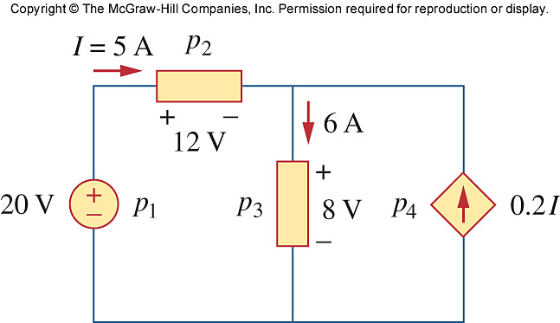
Example 1.7 Calculate the power supplied or absorbed by each element.

Slide 34
Example 1.7 Calculate the power supplied or absorbed by each element.
p₁ = - vi = -(20×5) = -100 W
p₂ = + vi = (12×5) = 60 W
p₃ = + vi = (8×6) = 48 W
p₄ = - vi = -(8×0.2I)
= - (8×0.2×5) = -8 W

Slide 35
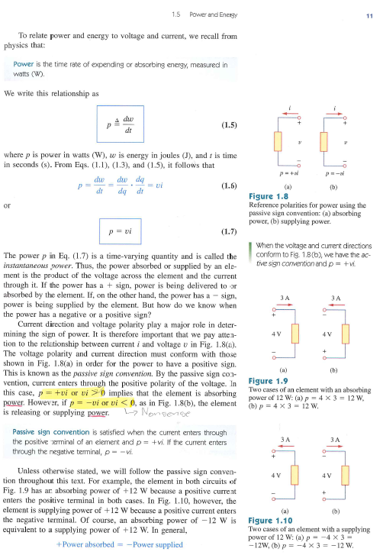
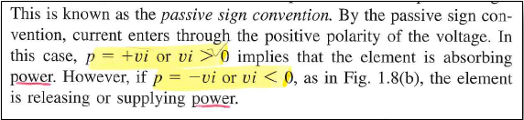
1.5 Power and Energy
Passive Sign Convention
BEWARE!
The extracted text on p 11 is very misleading as it is not stated accurately.
Please also avoid Fig. 1.8, 1.9 and 1.10 as they will create confusion regarding the passive sign convention and as to when power is being supplied or absorbed.
Please refer to the notes and examples provided in class. Specifically slides 18, 19 and 20 of Chapter 1 (Lecture #2)

